Slide 1


Foundations of
Scientific Computing
(SciComp 101)
Dave Biersach
dbiersach@bnl.gov
Session 15
Coding for Physics

Slide 2
Session 15 – Goals
How to simulate the trajectory of a circus cannon performer
Implement Euler’s Method for finding numerical solutions to physical laws represented as differential equations
Obtain Euler’s Method from Fermat's definition of the derivative
Model the radioactive decay of Carbon-14
Appreciate the importance of stability in numerical solutions
Use Euler’s Method to model the simple harmonic motion of a single (unforced, undamped) pendulum
Use the Euler-Cromer method to eliminate artificial energy gain in the long-term modeling of a system

Slide 3
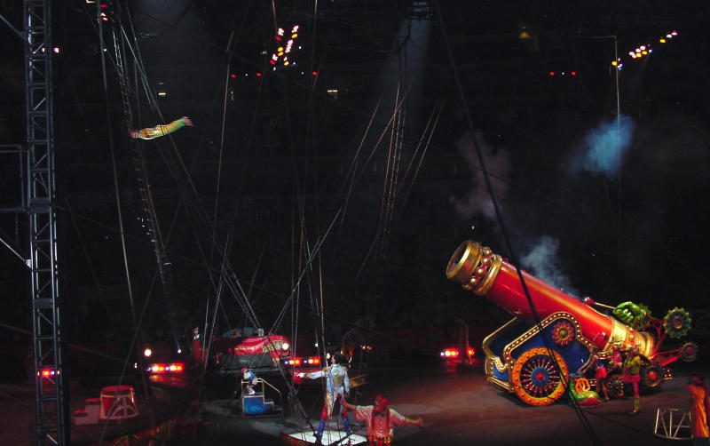
Projectile Motion

Slide 4
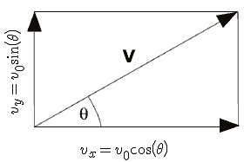








Projectile Motion
$v_{0}=$ Initial velocity leaving the cannon
$$x=v_{0}∗t∗\cos\left(θ\right)$$
$$y=v_{0}∗t∗\sin\left(θ\right)−\frac{1}{2}gt^{2}$$
$θ= \frac{π}{4}$
$$t= \frac{x}{v_{0}∗\cos\left(θ\right)}$$
Given the Range = 400m what does v₀ need to be?
$$y=\tan\left(θ\right)∗x−\frac{g}{2∗v_{0}^{2}∗\cos^{2}\left(θ\right)}∗x^{2}$$
$$h= \frac{v_{0}^{2}\sin^{2}(θ)}{2g}$$
This is the equation of motion that allows us to plot y as x increases from launch point to trampoline
$$Range= \frac{4h}{tan⁡(θ)}$$

Slide 5
Projectile Motion
$v_{0}=$ Initial velocity leaving the cannon
$$x=v_{0}∗t∗\cos\left(θ\right)$$
$$y=v_{0}∗t∗\sin\left(θ\right)−\frac{1}{2}gt^{2}$$
$θ= \frac{π}{4}$
$$t= \frac{x}{v_{0}∗\cos\left(θ\right)}$$
Given Range = 400m, what does v₀ need to be?
$$y=\tan\left(θ\right)∗x−\frac{g}{2∗v_{0}^{2}∗\cos^{2}\left(θ\right)}∗x^{2}$$
$$v_{0}=\sqrt{\frac{Range ∗g}{\sin{2θ}}}$$
This is the equation of motion that allows us to plot y as x increases from launch point to trampoline

Slide 6
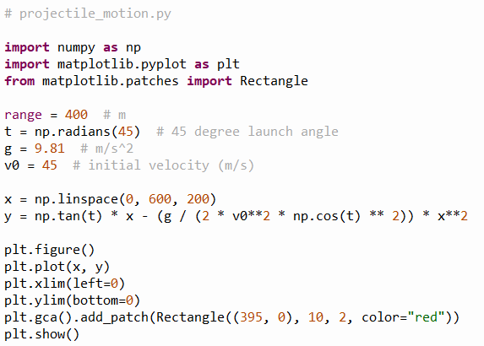
Open projectile_motion.py
①
②
③
④
⑤
⑥
⑦
⑧
⑨
⑩

Slide 7
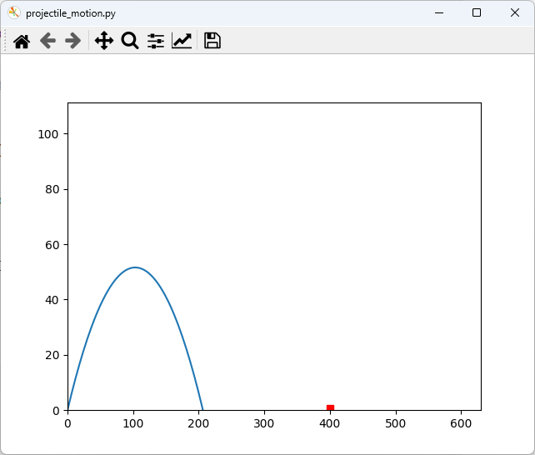
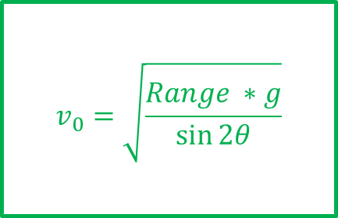
Run projectile_motion.py
What must the initial velocity of the performer leaving the cannon be to land safely on the trampoline?
SPLAT!

Slide 8
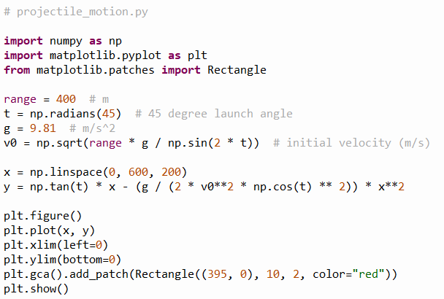
Edit projectile_motion.py
①

Slide 9
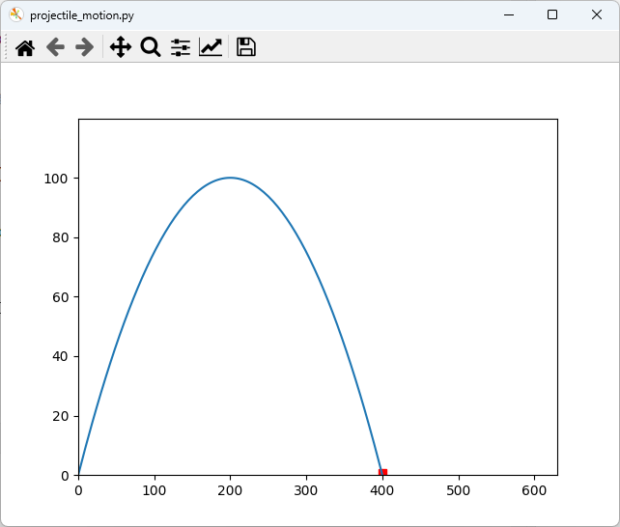
Run projectile_motion.py
SAFE!

Slide 10
Modelling Nuclear Decay
$N\left(t\right)≡$ number of nuclei at time t
$τ≡$ mean lifetime (half life)
$$\frac{dN}{dt}=−\frac{N(t)}{τ}$$
Fermat's Difference Quotient
$$\frac{dN}{dt}=\frac{N\left(t+Δt\right)−N(t)}{Δt}$$
$$−\frac{N(t)}{τ}=\frac{N\left(t+Δt\right)−N(t)}{Δt}$$
$$N\left(t+Δt\right)=N\left(t\right)−\frac{N(t)}{τ}Δt$$
This is Euler’s Method

Slide 11
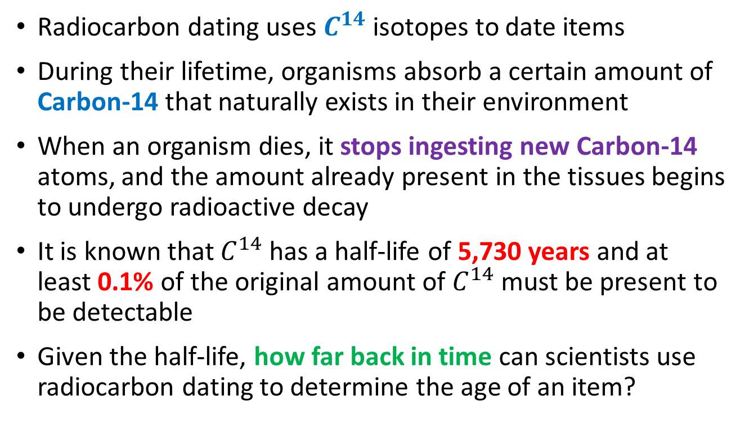
Modelling Carbon-14 Decay
Radiocarbon dating uses $C^{14}$ isotopes to date items
During their lifetime, organisms absorb a certain amount of Carbon-14 that naturally exists in their environment
When an organism dies, it stops ingesting new Carbon-14 atoms, and the amount already present in the tissues begins to undergo radioactive decay
It is known that $C^{14}$ has a half-life of 5,730 years and at least 0.1% of the original amount of $C^{14}$must be present to be detectable
Given the half-life, how far back in time can scientists use radiocarbon dating to determine the age of an item?

Slide 12
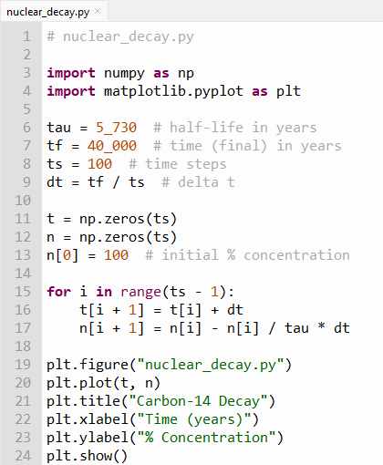


Edit nuclear_decay.py
①
$C^{14}$ has a half-life of 5,730 years
②
③
④
⑤
Type this code into your file
⑥
⑦
⑧
⑨
⑩

Slide 13
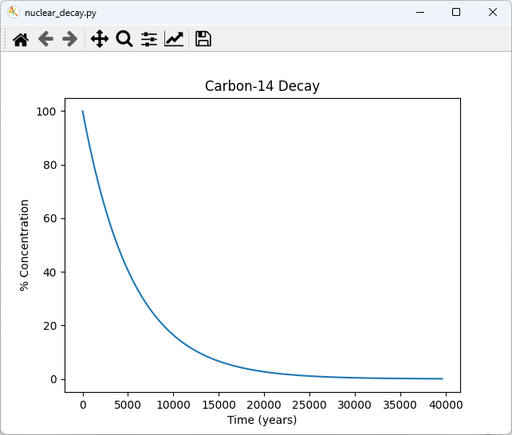
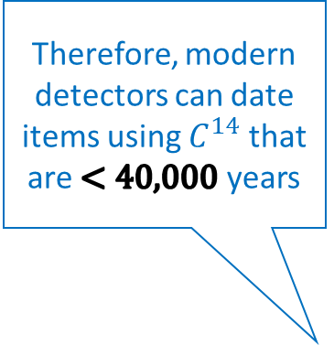
Run nuclear_decay.py
Therefore, modern detectors can date items using $C^{14}$ that are $<40,000$ years
At least 0.1% of the absorbed Carbon-14 must be present to be detectable

Slide 14
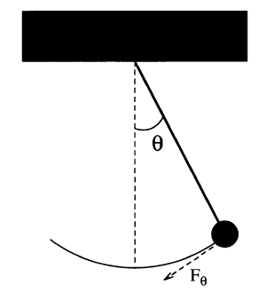
Modelling a Simple Pendulum
Gravity is a restoring force
$$F_{θ}=−mg\sin{θ}$$
$$l$$
length of rod (constant)
$$ml\frac{d^{2}θ}{dt^{2}}=−mg\sin{θ}$$
But Euler’s Method works only on first order ODEs! ☹
$$\frac{d^{2}θ}{dt^{2}}=−\frac{g}{l}\sin{θ}$$
$$s=0$$
$$s=lθ$$
$$F=ma$$
$$\frac{dω}{dt}=−\frac{g}{l}\sin{θ}$$
Take 2nd derivative of both sides with respect to time
We can break the 2nd order ODE into two linked first-order ODEs and use Euler’s method on each
$$F=m\frac{d^{2}s}{dt^{2}}$$
$$\frac{dθ}{dt}=ω$$
$$\frac{d^{2}s}{dt^{2}}=l\frac{d^{2}θ}{dt^{2}}$$
$$F_{θ}=ml\frac{d^{2}θ}{dt^{2}}$$

Slide 15
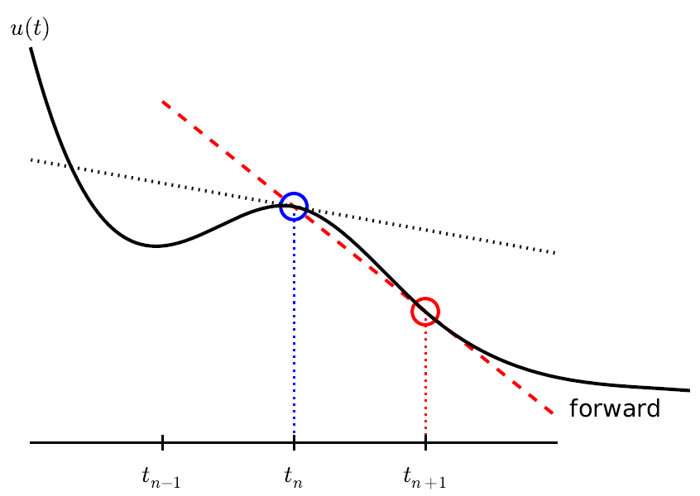

Modelling a Simple Pendulum
$$\frac{dω}{dt}=−\frac{g}{l}\sin{θ}$$
$$ω_{i+1}=ω_{i}−\frac{g}{l}\sin{θ_{i}}Δt$$
$$l$$
$$\frac{dθ}{dt}=ω$$
$$θ_{i+1}=θ_{i}+ω_{i}Δt$$
This is Euler’s Method
in time…

Slide 16
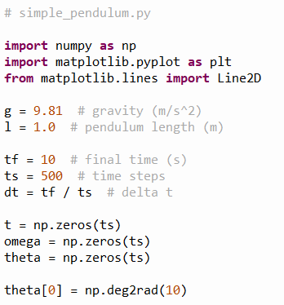


Open simple_pendulum.py
①
1m
②
③
$${10}^{°}$$
④
⑤
⑥
⑦
Initial angular displacement $θ={10}^{°}=0.17 radians$

Slide 17
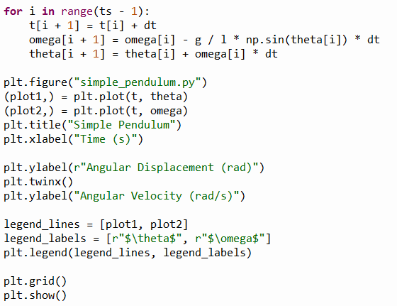

View simple_pendulum.py
This is Euler’s Method
①
$$\frac{dω}{dt}=−\frac{g}{l}\sin{θ}$$
②
$$\frac{dθ}{dt}=ω$$
③
④
⑤
⑥

Slide 18
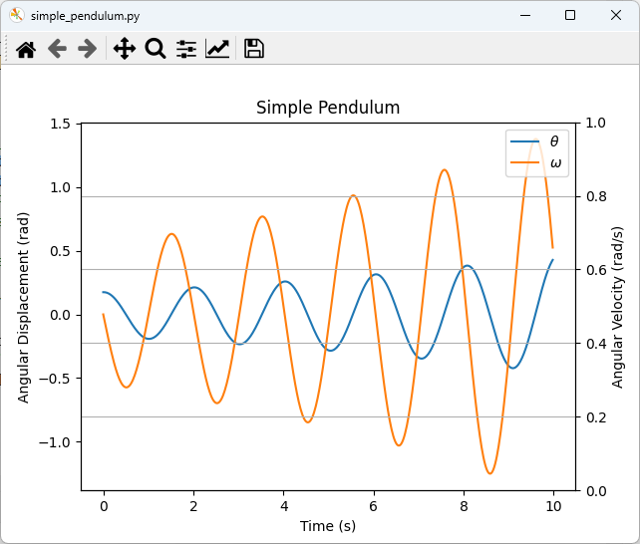

Run simple_pendulum.py
Initial pendulum angular displacement from centerline
$$θ_{0}=0.17 rad$$
This is not good… The model predicts the pendulum will begin to swing wildly, which would not happen naturally!

Slide 19
Numerical Instability of Euler's Method For Oscillatory Modes
kinetic
potential
Increasing the number of time steps by 10x does not prevent the displacement from growing after each oscillation
The simple forward Euler method can be unstable for harmonic motion
The energy in the system is artificially growing over time without bounds because no term can be negative
$$E=\frac{1}{2}ml^{2}ω^{2}+mgl(1−\cos{θ})$$
$$\left(θ<{22}^{°},\cos{θ}≈1−\frac{θ^{2}}{2}\right)$$
Small angle identity
$$E=\frac{1}{2}ml^{2}\left(ω^{2}+\frac{g}{l}θ^{2}\right)$$
$$E_{i+1}=E_{i}+\frac{1}{2}mgl^{2}\left(ω_{i}^{2}+\frac{g}{l}θ_{i}^{2}\right){\left(Δt\right)}^{2}$$
Due to the squaring of values,
the next energy state will always be incorrectly higher than the previous energy state

Slide 20
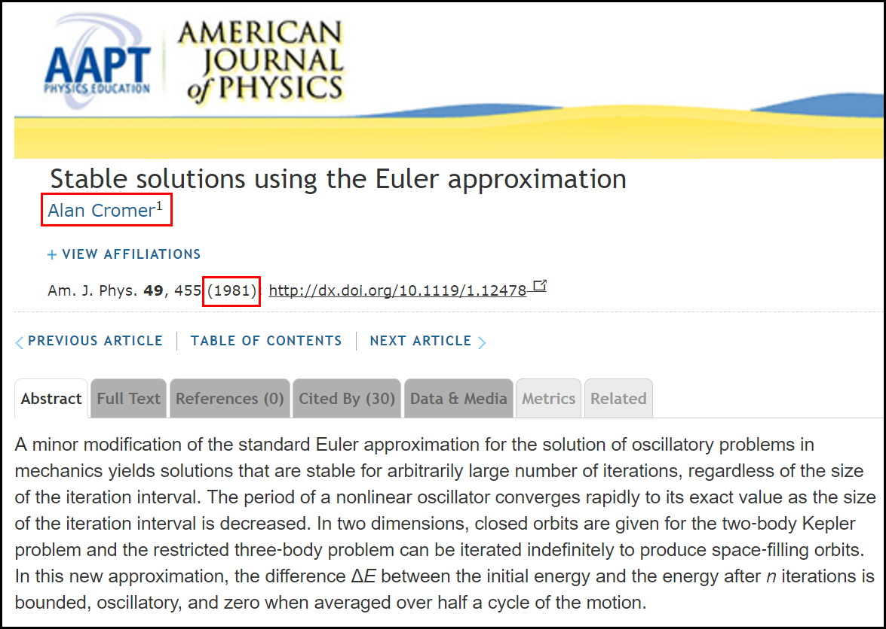
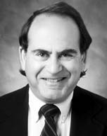
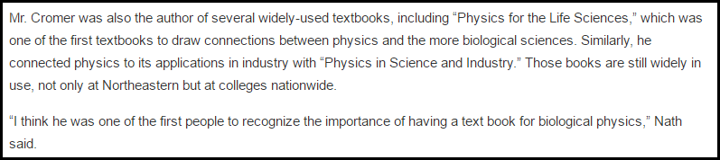
Cromer's Fix to Euler's Method

Slide 21
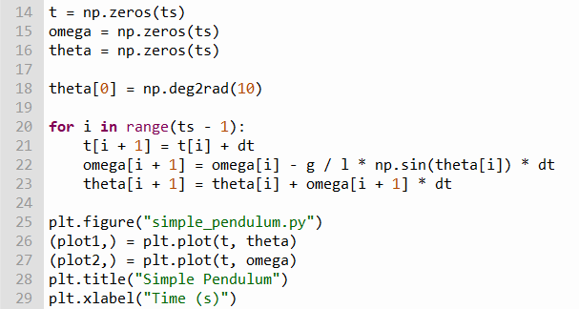

Edit simple_pendulum.py
Notice that the original ODEs don't change, just how we calculate them!
The
Euler-Cromer
Method
①
We must use the next value for $ω$, not the current value of $ω$
$$\frac{dω}{dt}=−\frac{g}{l}\sin{θ}$$
$$\frac{dθ}{dt}=ω$$

Slide 22
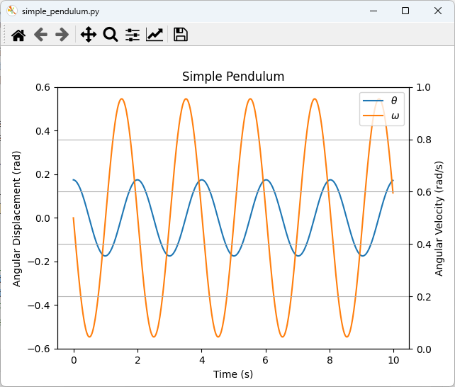
Run simple_pendulum.py
This simulation is now numerically stable
What is the physics story at these circled times?

Slide 23
Damped Harmonic Oscillator
In real oscillators, friction (or damping) slows the motion of the system. Due to frictional force, the velocity decreases in proportion to the acting frictional force
In contrast to a simple undriven harmonic oscillator (where the only force acting on the mass is the restoring force) in a damped harmonic oscillator there is in addition a frictional force which is always acts in the direction opposing the motion
We always strive to develop mathematical models that are as realistic as possible – friction is hard to avoid in the real world and therefore should not be ignored in a simulation

Slide 24
Damped Harmonic Oscillator
$$\frac{d^{2}θ}{dt^{2}}=−\frac{g}{l}\sin{θ}$$
We can introduce a new resistive force term into the equation of motion for a pendulum
$$\frac{d^{2}θ}{dt^{2}}=−q\frac{dθ}{dt}−\frac{g}{l}\sin{θ}$$
$q$= damping_constant
$$\frac{dω}{dt}=−qω−\frac{g}{l}\sin{θ}$$
$$\frac{dθ}{dt}=ω$$

Slide 25
Damped Harmonic Oscillator
Underdamped – The system swings back and forth (oscillates) over its equilibrium point, but ultimately comes to rest
Example: $q=1$
Overdamped – The system never oscillates, but it takes a while for it to return to its equilibrium point
$$\text{Example}\text{:} q=\frac{{\left(phase_constant\right)}^{2}}{2}$$
Critically damped – The system never oscillates and returns to its equilibrium point in the least amount of time
$$q=\frac{{\left(phase_constant\right)}^{2}}{4}$$
Note: There is only one value for $q$ where the system is critically damped

Slide 26
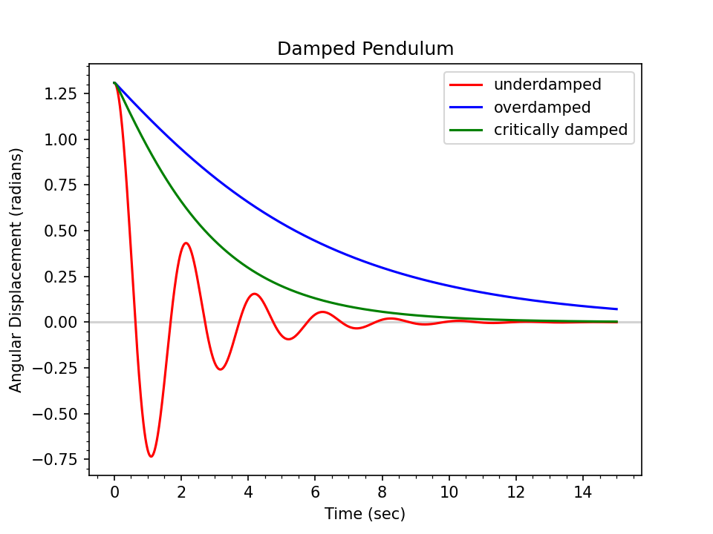
Damped Harmonic Oscillator
In what applications would you want a system to be critically damped?

Slide 27
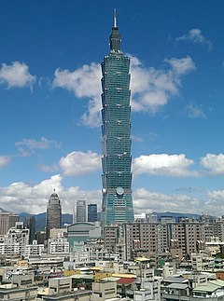
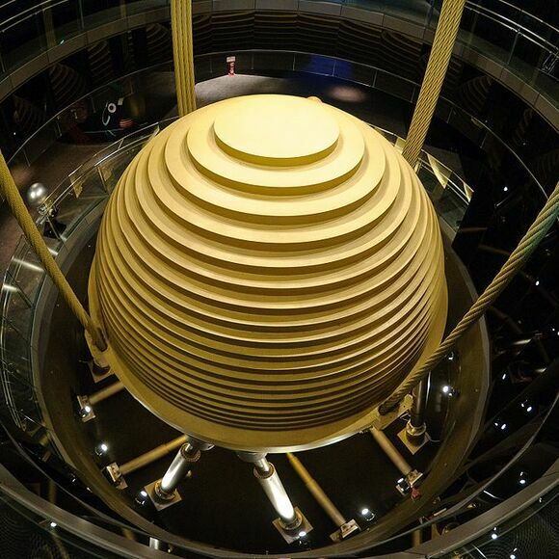
Tuned Mass Dampers
Taipei 101 – Taiwan
The Worlds Tallest Building (2004-2009)
730 Tons

Slide 28
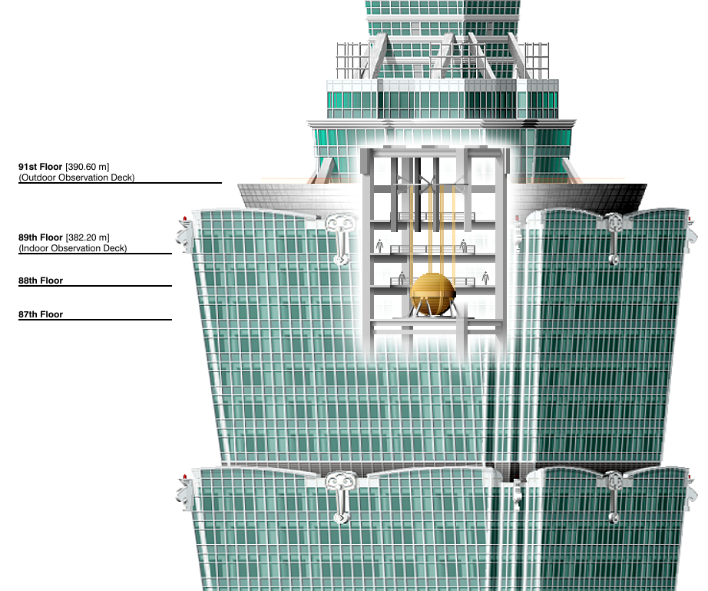
Tuned Mass Dampers
365 Minivans

Slide 29

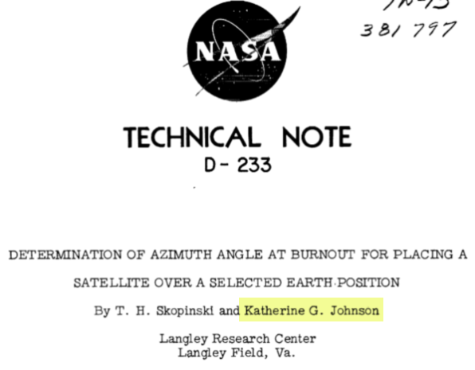
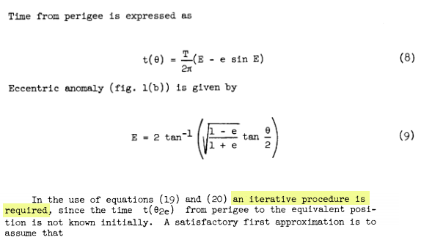
Hidden Figures, Fox 2000 Pictures, 2016
Euler’s Method

Slide 30
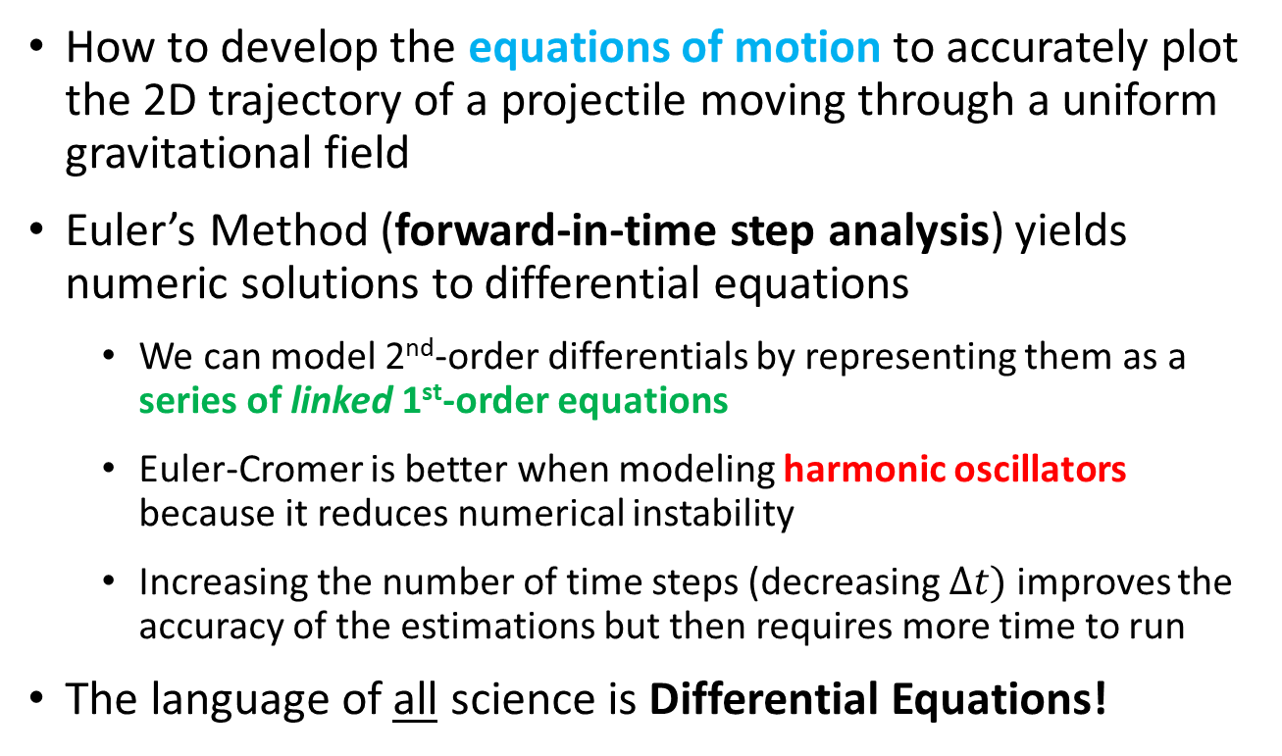
Session 15 – Know You Know…
How to develop the equations of motion to accurately plot the 2D trajectory of a projectile moving through a uniform gravitational field
Euler’s Method (forward-in-time step analysis) yields numeric solutions to differential equations
We can model 2nd-order differentials by representing them as a series of linked 1st-order equations
Euler-Cromer is better when modeling harmonic oscillators because it reduces numerical instability
Increasing the number of time steps (decreasing $∆t)$ improves the accuracy of the estimations but then requires more time to run
The language of all science is Differential Equations!

Slide 31
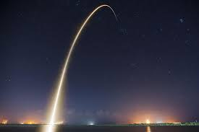
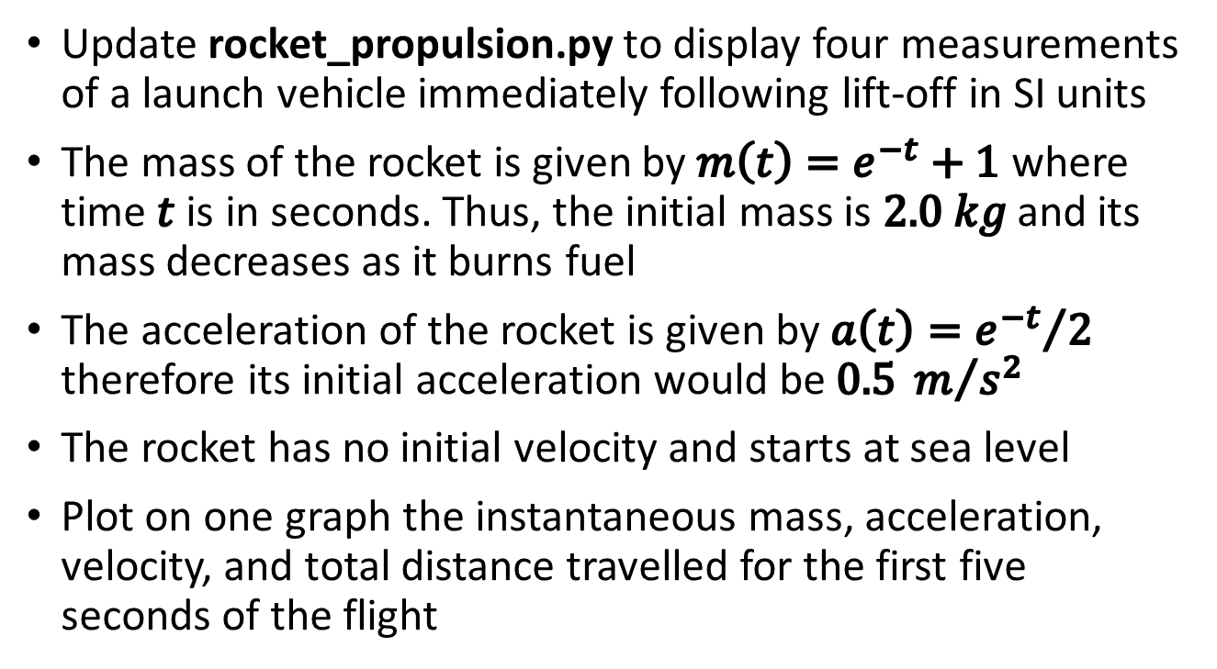
Task 15
Update rocket_propulsion.py to display four measurements of a launch vehicle immediately following lift-off in SI units
The mass of the rocket is given by $m\left(t\right)=e^{−t}+1$ where time $t$ is in seconds. Thus, the initial mass is $2.0 kg$ and its mass decreases as it burns fuel
The acceleration of the rocket is given by $a\left(t\right)={e^{−t}}/2$ therefore its initial acceleration would be $0.5 m/{s^{2}}$
The rocket has no initial velocity and starts at sea level
Plot on one graph the instantaneous mass, acceleration, velocity, and total distance travelled for the first five seconds of the flight

